Slide 1













Feb 01, 2024
TALK BUDDY NET NEXUS
An Object-Oriented Java Swing Chatting Application with Socket Programming for Seamless Server-Client Communication and Dynamic Group Chatting & Interaction as well as One-on-One Private Chatting & Interaction.

Slide 2

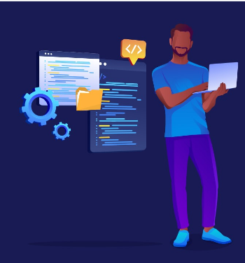



About me
Allow me to introduce myself. I am Muhammad Ahmad Sultan, a highly motivated second-year student at the Military College of Signals, currently pursuing a Bachelor's degree in Software Engineering. With unwavering determination, I am committed to achieving my goals and making significant strides in my academic journey.
Muhammad Ahmad Sultan
Developer

Slide 3






06
Abstract
History
07
Objective
08
Agenda
Scope
09
TALK BUDDY NET NEXUS
Beyond Current
focus
11
Functionality &
Implementation
12

Slide 4



MySQL Schema
15
Java Classes
16
Input & Output
Specifications
Agenda
26
OOP Concepts
28
TALK BUDDY NET NEXUS
Software &
Equipment Used
33
Execution & Output
34

Slide 5



TALK BUDDY NET NEXUS
Project Demo
36
Project Plan, Team,
Budget & Timeline
39
Agenda
Future Enhancements
42
Potential Q/A
43
Conclusion
44
Reference Citations
45

Slide 6


Talk Buddy NET NEXUS
Abstract
Java-based chat application using Java Swing, AWT, Socket Programming, and MySQL Workbench.
Splash window for project identification.
User authentication via MySQL database.
One-on-one private chatting.
Dynamic group chatting with multithreading.
User-friendly interface.
Robust communication architecture.
Real-time individual and group interactions.
06

Slide 7
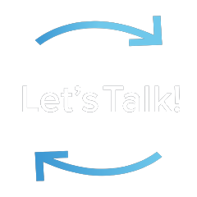
Object-Oriented Talk Buddy
History
Late 1960s and early 1970s:
Development of computer networks like ARPANET, laying the groundwork for the first online chat systems.
1971:
Douglas Engelbart developed the "On-Line System" (NLS) with a message group chat feature, a milestone in online communication.
1990s:
Emergence of Internet Relay Chat (IRC), enabling real-time text-based chat rooms and private messaging.
Late 1990s:
Rise of instant messaging applications like ICQ, AIM, and MSN Messenger, revolutionizing online communication.
Early 2000s:
Introduction of voice and video chat capabilities with platforms like Skype and Google Talk, enriching online communication.
Today:
Dominance of mobile chat apps like WhatsApp, Facebook Messenger, and WeChat, offering diverse features for modern users.
07

Slide 8


Objective
Real-time Communication Enhancement
Comprehensive Chatting Application Development
Enhanced User-to-User Messaging
Group Chatting with Multithreading
Message Delivery and Receipt Assurance
Text-based Communication Support
Intuitive User Interface Design
Robust Client-Server Architecture Implementation
Effective Socket Programming Utilization
User Authentication
08

Slide 9




Scope
Real-time Communication
Message Sending and Receiving
User Authentication
Private Chatting
Testing and Quality Assurance
Group Chatting
Online Status and Presence Management
Splash Window
09

Slide 10
Scope
Time-stamped Messages
Message Delivery Confirmation
Multi-threading for Group Chats
Error Handling
User-Interface Enhancement
Refactoring & Optimization
Graphical User Interface (GUI) Development
10

Slide 11


Beyond Current
Focus
Audio and Video Calls
Voice Messaging
Artificial Intelligence-based Features
File Transfer
Multiple Language Support
11

Slide 12
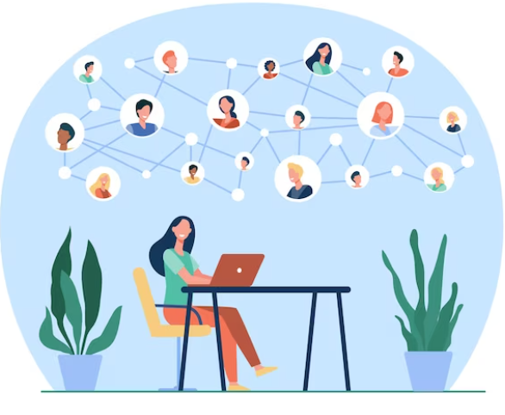
Project
Functionality & Implementation
12

Slide 13
Functionality & Implementation
Splash Window (MainWindow.java):
Displays project name, description, and developer name.
Implemented using Java Swing components.
User Authentication (Login.java, dbConnectivity.java):
Allows users to log in with credentials stored in a MySQL database.
Login.java: Manages login interface.
dbConnectivity: Establishes JDBC connection for authentication.
One-on-One Private Chatting (Server.java, Client.java):
Enables private messaging between server and client.
Server.java: Handles server-side communication.
Client.java: Manages client-side communication.
Group Chatting (ServerBroadcast.java, FirstUser.java, SecondUser.java, ThirdUser.java):
Facilitates group messaging with broadcast functionality.
ServerBroadcast.java: Broadcasts messages to all clients.
FirstUser.java, SecondUser.java, ThirdUser.java: Individual client threads.
13

Slide 14
Functionality & Implementation
Multithreading for Group Chatting:
Utilizes multithreading for efficient concurrent messaging.
Implemented in ServerBroadcast.java, FirstUser.java, SecondUser.java, ThirdUser.java.
Socket Programming:
Enables real-time communication between server and clients.
MySQL Database Management:
Manages user credentials with MySQL Workbench.
JDBC connectivity for database interaction.
Graphical User Interface (GUI):
User-friendly interface using Java Swing and Java AWT.
14

Slide 15



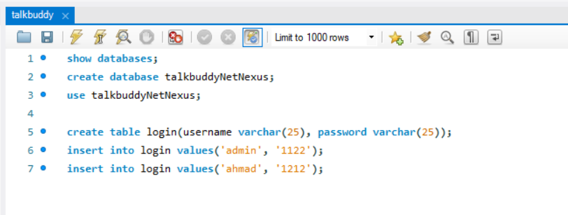
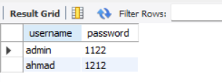
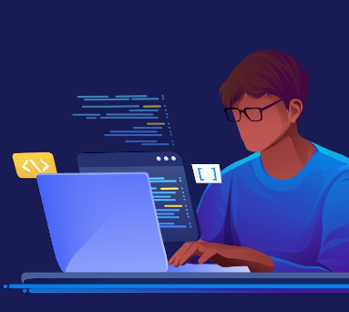
MYSQL SCHEMA
These SQL commands create a new database named "talkbuddyNetNexus," switch to that database for further operations, create a table named "login" with columns for username and password, and insert two sets of login credentials into the table: ('admin', '1122') and ('ahmad', '1212').
15

Slide 16
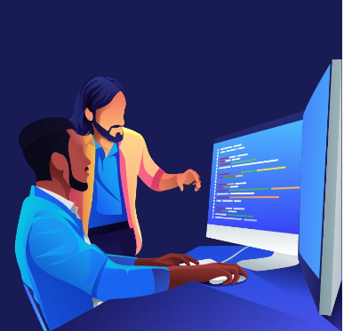
MainWindow.java
Login.java
Classes
dbConnectivity.java
Server.java
Client.java
Client.java
16

Slide 17
ServerBroadCast.java
Classes
FirstUser.java
SecondUser.java
ThirdUser.java
17

Slide 18
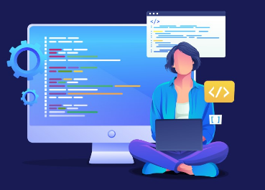
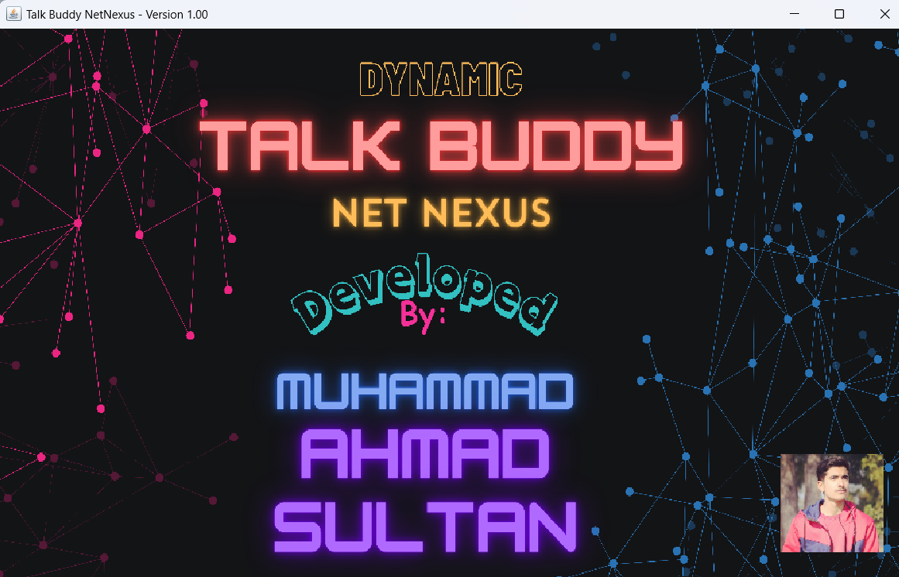
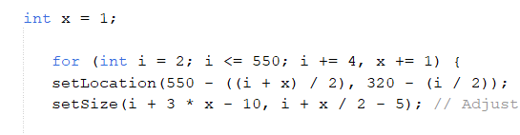
MainWindow.java
Purpose:
Displays a splash window showing project name, description, and developer name.
Functions:
Initialize and display the splash window.
Set project name, description, and developer name.
Handle window closing events.
18

Slide 19
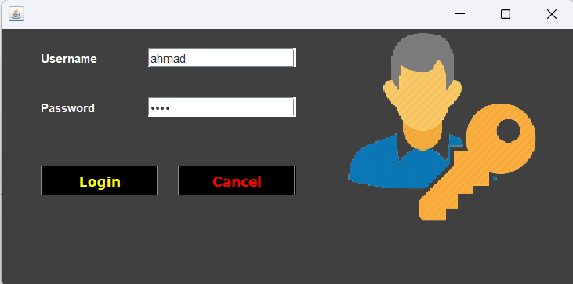
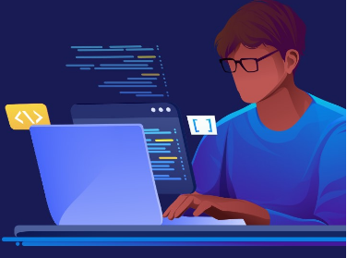
Login.java
Purpose:
Handles user authentication using username and password stored in the MySQL database.
Functions:
Display login interface.
Validate user credentials using dbConnectivity.
Handle login success and failure events.
19

Slide 20
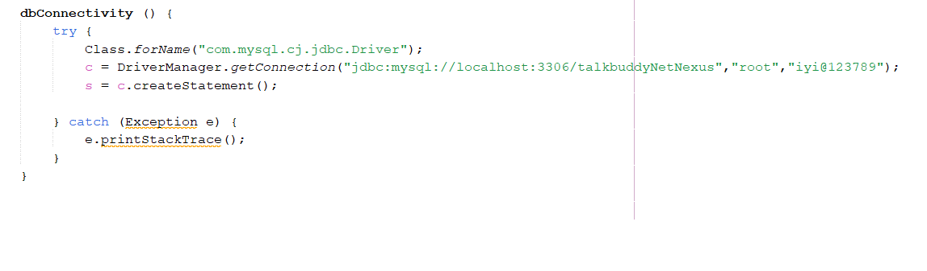
dbConnectivity.java
Purpose:
Establishes JDBC connection with MySQL Workbench database for user authentication.
Functions:
Establish database connection using JDBC.
Execute queries to validate user credentials.
Handle database connection errors.
20

Slide 21
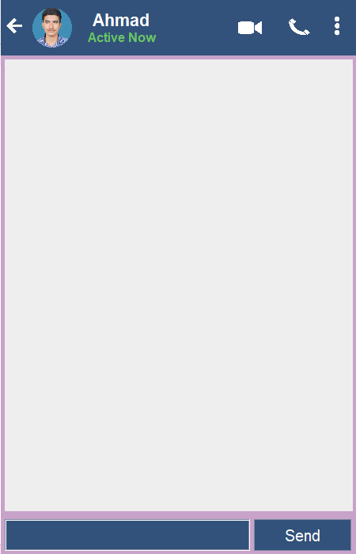
Server.java
Purpose:
Manages one-on-one private chatting between server and client.
Functions:
Initialize server socket and accept client connections.
Manage client-server communication for private chatting.
Handle disconnection events.
21

Slide 22
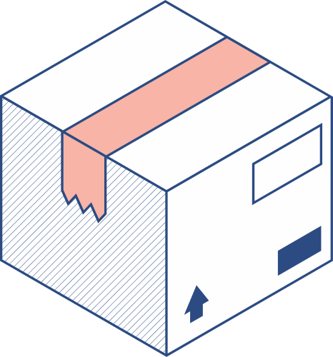


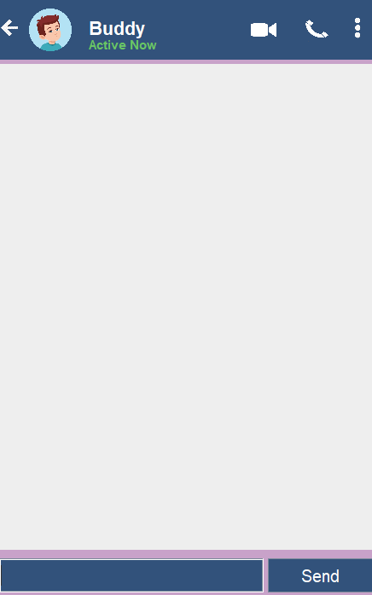
Client.java
Purpose:
Represents a client for one-on-one private chatting.
Functions:
Connect to the server.
Send and receive messages to/from the server.
Handle disconnection events.
22

Slide 23
ServerBroadCast.java
Purpose:
Manages group chatting functionality by broadcasting messages from one client to all other connected clients.
Functions:
Receive messages from the first user (client).
Broadcast messages to all other users (clients).
23

Slide 24
ServerBroadCast.java
Purpose:
Manages group chatting functionality by broadcasting messages from one client to all other connected clients.
Functions:
Receive messages from the first user (client).
Broadcast messages to all other users (clients).
24

Slide 25

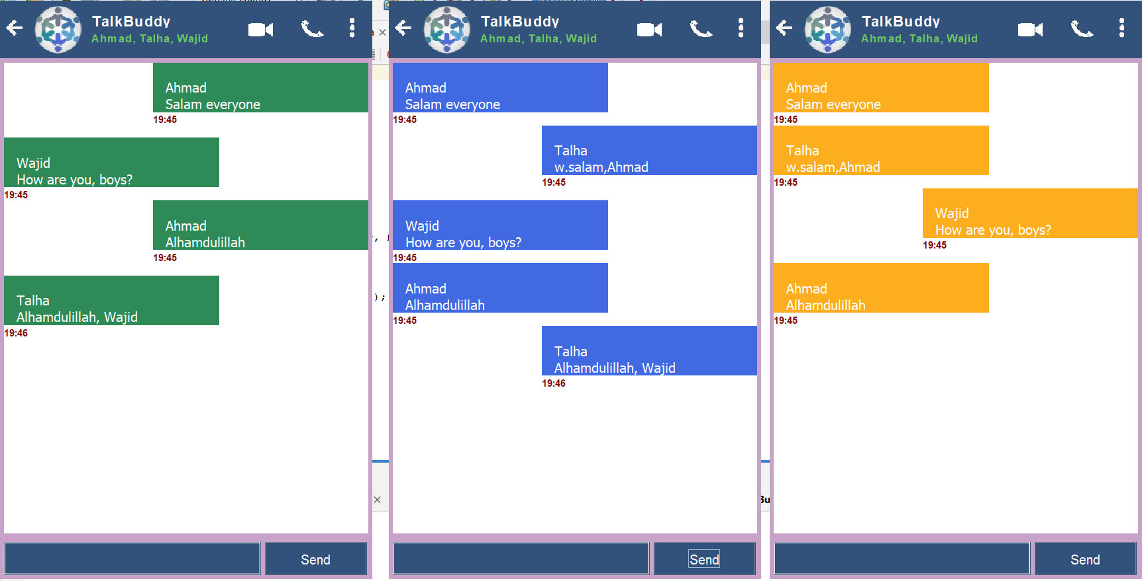
FirstUser.java, SecondUser.java, ThirdUser.java
Purpose:
Represents individual users in the group chat.
Functions:
Receive and display messages from the server.
Send messages to the server.
25

Slide 26
Input Specifications | Output Specifications
• Username and Password:
Input from the user during the login/authentication process.
• Chat Messages:
Input from users for one-on-one private chatting or group chatting.
• Commands (for server):
Input commands to start, stop, or manage the server's functionality.
• Splash Window (MainWindow.java):
Output: Display of project name, description, and developer name.
• User Authentication (Login.java):
Output: Successful or failed authentication message.
• One-on-One Private Chat (Server.java and Client.java):
Output: Exchange of private messages between two users.
• Group Chat (ServerBroadcast.java, FirstUser.java, SecondUser.java, ThirdUser.java):
Output: Broadcasting of messages from one user to all other connected users in the group.
• Database Connectivity (dbConnectivity):
Output: Connection status messages (success or failure) during database operations.
26

Slide 27


Overall Interaction
• User Interaction:
Users interact with the application through the graphical user interface provided by Java Swing and Java AWT components.
Users input their credentials for authentication and exchange messages during chatting sessions.
• Server Interaction:
The server manages communication channels, handles authentication requests, and facilitates message broadcasting for group chatting.
Server interacts with the MySQL database for user authentication and storage of login credentials.
• Database Interaction:
The application interacts with the MySQL database for user authentication purposes, validating login credentials provided by users.
• Multithreading Interaction:
Multithreading is utilized for efficient handling of multiple client connections and simultaneous message broadcasting in group chatting.
27

Slide 28


Object-Oriented
Programming
Concepts
28

Slide 29


ENCAPSULATION
POLYMORPHISM
INHERITANCE
Inheritance is the process by which one class (called the subclass) acquires the properties and behavior of another class (called the superclass). This allows for the creation of hierarchical classifications of objects, where subclasses inherit the characteristics of their super classes and add additional functionality.
Encapsulation is a mechanism that binds data and code together, protecting them from external interference and misuse. It is achieved through the use of access modifiers such as public, private, and protected, which control the visibility of data and methods in a class
Polymorphism is a feature that allows objects of different classes to be treated as if they belong to a common class. This means that a single interface or method can be used to perform operations on objects of different types. This is achieved through the use of method overloading and overriding, as well as through the implementation of interfaces and abstract classes.
29

Slide 30
OOP Concept
Classes and Objects:
The TalkBuddy NetNexus chat application employs various classes like MainWindow, Login, dbConnectivity, Server, Client, ServerBroadcast, FirstUser, SecondUser, and ThirdUser.
Objects of these classes represent different functionalities within the chat application, such as the splash window, user authentication, database connectivity, server-client communication for one-on-one chatting, and multithreading for group chatting.
Inheritance:
Inheritance establishes relationships between classes in TalkBuddy NetNexus.
For example, a base class like Server can be extended by subclasses like Client, ServerBroadcast, FirstUser, SecondUser, and ThirdUser to inherit common attributes and behaviors related to server-client communication.
30

Slide 31
OOP Concept
Encapsulation:
Encapsulation is a fundamental concept applied to classes in TalkBuddy NetNexus to encapsulate data and functionality securely.
For example, the Login class encapsulates user authentication details like username and password, providing methods to securely access and verify this information.
Method Overriding:
Method overriding is implemented when custom implementations of inherited methods are needed in TalkBuddy NetNexus.
For instance, the sendMessage() method in the Server class can override the same method in a superclass to handle one-on-one private chatting, while the broadcastMessage() method in the ServerBroadcast class can override the same method to handle group chatting.
31

Slide 32
OOP Concept
Constructor:
Constructors are vital components in various classes of TalkBuddy NetNexus to initialize object properties during their creation.
For example, a constructor in the MainWindow class can be utilized to set initial values such as project name, description, and developer name, ensuring proper initialization of the splash window.
Polymorphism:
Polymorphism is applied in TalkBuddy NetNexus to treat objects of different classes as instances of a common superclass or interface.
For flexibility and code reusability, methods that handle message transmission can accept both Server and Client objects, treating them as instances of a common ChatObject superclass.
By leveraging these Object-Oriented Programming (OOP) principles, TalkBuddy NetNexus ensures a
robust and maintainable codebase. This approach facilitates efficient communication and interaction
within the chat application, promoting flexibility and scalability.
32

Slide 33
Hardware Requirements | Software Requirements
No specific hardware requirements are mentioned, ensuring flexibility in deployment across various computing environments and configurations.
Computer: Required for development and running the Java-based chat application.
Input Devices: for instance, Keyboard, Mouse etc.
Output Devices: for instance, Monitor, Speakers etc.
Java Swing
Java AWT (Abstract Window Toolkit)
Socket Programming
MySQL Workbench
JDBC (Java Database Connectivity)
Networking libraries
Java Development Kit (JDK)
Integrated Development Environment (IDE)
Operating System (e.g., Windows, macOS,
Linux)
33

Slide 34

Execution &
Output
34

Slide 35
Execution Flow:
Launch the application.
Splash window appears, displaying project details.
Enter username and password for authentication.
Upon successful login, the main chat interface is displayed.
Engage in one-on-one private chatting or initiate/join group chats.
Messages are transmitted in real-time between users.
Output:
Upon successful execution, users can seamlessly communicate via private or group chats within the application's user-friendly interface.
Real-time message transmission ensures a dynamic and responsive chatting experience.
User authentication adds a layer of security, preventing unauthorized access to the chat application.
35

Slide 36
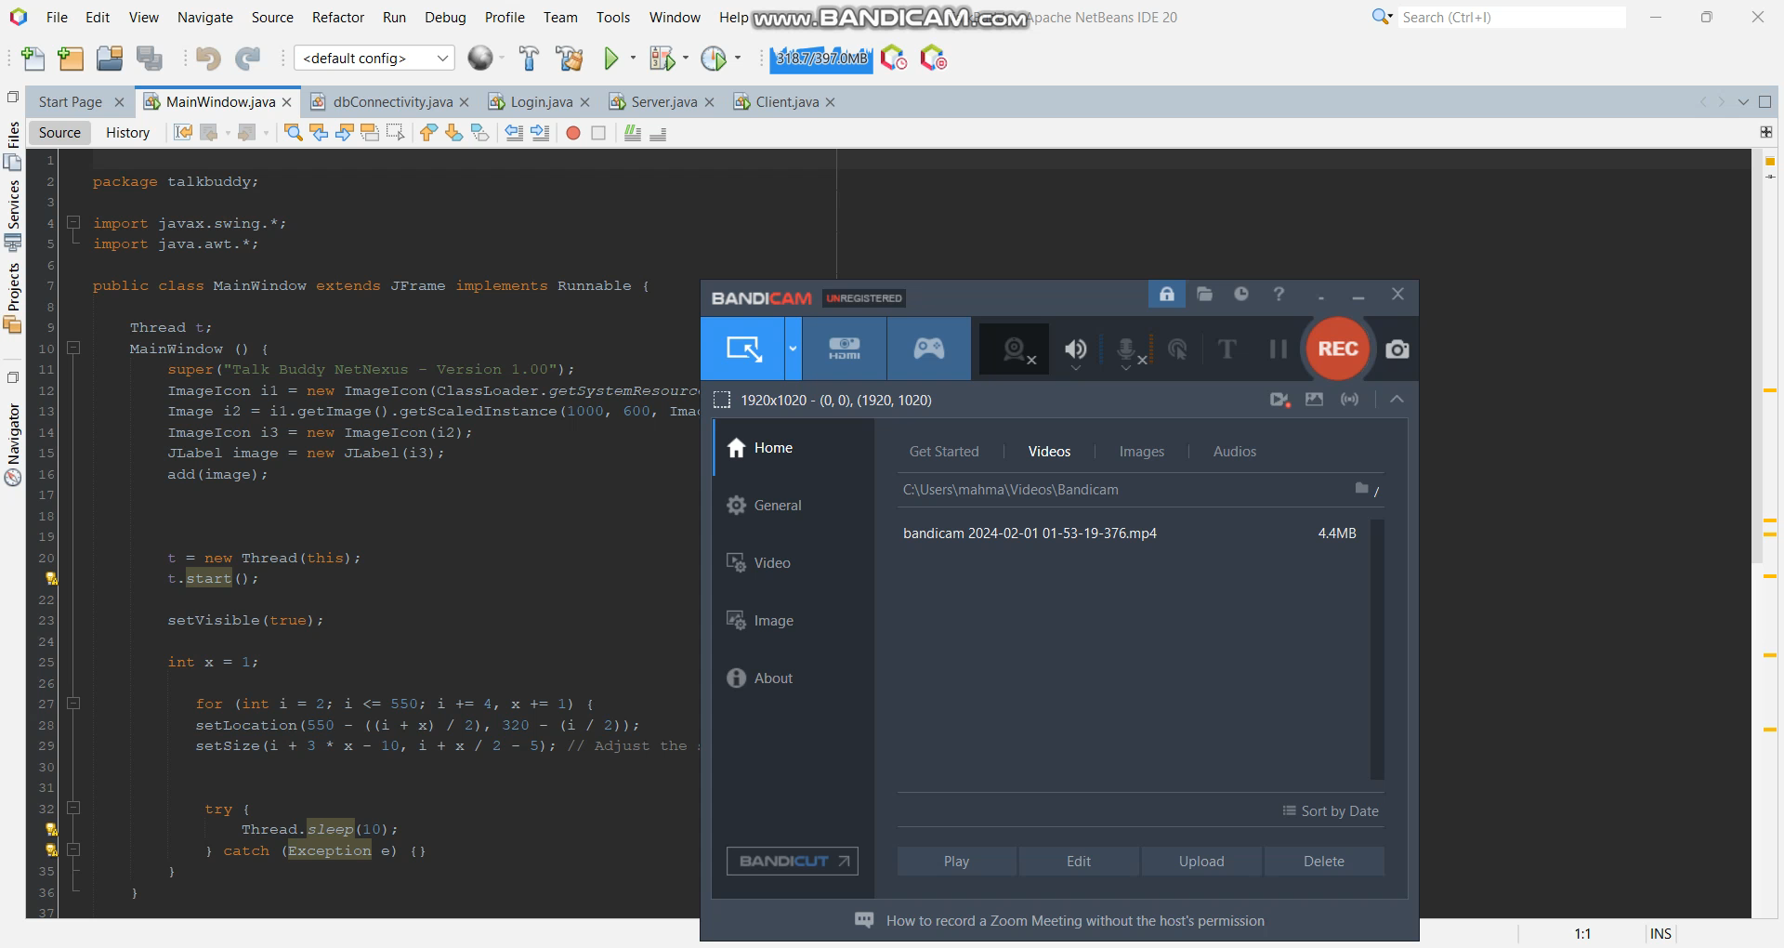


Project Demo
36

Slide 37

Project Demo
37

Slide 38

Project Demo
38

Slide 39
Project Plan
01
02
03
Design Phase
Implementation
Phase
Testing
Phase
Identify chat application features and requirements, plan chat application design with OOP concepts, create UI wireframes.
Develop chat application UI, implement chat application logic and rules, implement chat application settings
Conduct thorough testing, test on different systems, ensure requirements are met, optimize performance
39

Slide 40
Project Budget & Team
This project will be developed using open-source tools and software, therefore there will be no cost involved.
The project will be developed by a team of one developer only.
40

Slide 41







Project Timeline
Five Weeks
1
2
3
4
5
Brainstorming and Idea Generation
Idea Selection
Design Phase
(1 Week)
Implementation
Phase
(3 weeks)
Testing Phase
(1 week)
41

Slide 42
Future Enhancements & Works
Enhanced Audio and Video Calls:
AI-based Chat Assistant:
Voice Recognition and Control:
Advanced Chat Moderation
Enhanced Security Features:
Enhanced Security Features:
Customization and Personalization:
File Transfer
42

Slide 43

Potential Questions
Q) What were the key factors that influenced the design and implementation of the splash window feature in your chat client? How did this introductory element contribute to setting the tone and user experience of the application?
Q) Can you share insights into the impact of implementing multithreading for group chatting functionality in terms of improving real-time message broadcasting efficiency? How did this feature contribute to a more dynamic and interactive chatting experience for users?
Q) How can artificial intelligence and natural language processing techniques be leveraged to improve the chat client's functionality, such as providing automated suggestions, intelligent message filtering, or sentiment analysis?
1
2
3
43

Slide 44
Conclusion
In a nutshell, TalkBuddy NetNexus represents a comprehensive and dynamic chat client that has evolved to meet the evolving needs of modern communication. Beginning with one-on-one private chatting capabilities, the project expanded to include a range of features designed to enhance user experience and interaction. From the convenience of a splash window introduction to the security of user authentication via MySQL Workbench, each element of the application has been meticulously crafted to ensure a seamless and engaging chatting experience. The addition of group chatting functionality, powered by multithreading concepts, further elevates the application, fostering collaborative discussions among users. Looking ahead, the potential for future enhancements, such as audio and video calls, AI-based features, and multi-language support, promises to continue pushing the boundaries of what is possible within the realm of chat clients. With its blend of innovation, functionality, and user-centric design, TalkBuddy NetNexus stands as a testament to the power of thoughtful development and a commitment to meeting the needs of users in an ever-changing digital landscape.
44

Slide 45
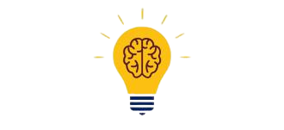
Reference Citations
https://www.codecademy.com/learn/learn-java
https://www.geeksforgeeks.org/socket-programming-cc/
https://www.geeksforgeeks.org/computer-network-tutorials/
https://www.learnjavaonline.org/
https://www.w3schools.com/
https://stackify.com/java-tutorials//
https://www.edureka.co/blog/socket-programming-in-java
45

Slide 46

Any Questions?
Thank you all for your attention! Before we conclude,
I would like to open the floor for questions. Please
feel free to ask anything related to the presentation
or any additional points you'd like to discuss.
46

Slide 47


THANK YOU
Sincerely for your kind attention
47

